Slide 1
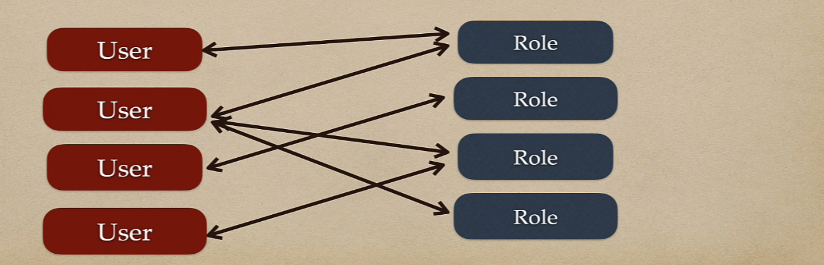
Many to Many Mapping
We will take User and the Role entities to perform Many to Many mapping.
User has many roles and Role has many users.

Slide 2
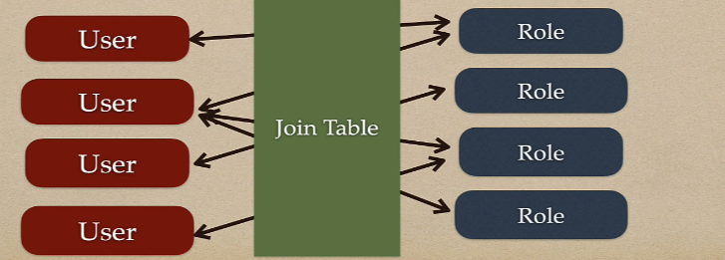
Join table to keep track of relationships
Need to keep track of which User has which role and vice versa.
The many-to-many relationship is implemented using a third table called join table which contains foreign key for each table.

Slide 3
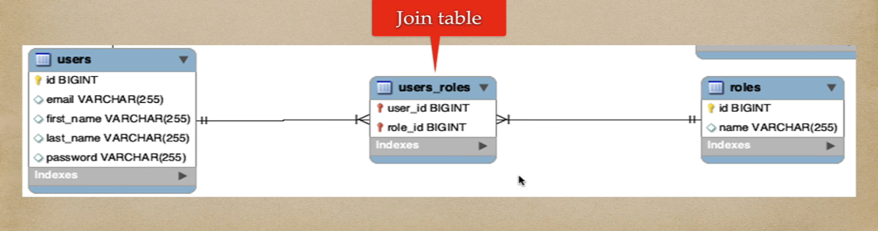
Many to Many Mapping – ER diagram
The many-to-many relationship is implemented using a third table called join table which contains foreign key for each table.

Slide 4
JPA Annotations for Many to Many Mapping
The @ManyToMany JPA annotation is used to link the source entity with the target entity.
A many-to-many association always uses an intermediate join table to store the association that joins two entities. The join table is defined using @JoinTable JPA annotation.

Slide 5
Many to Many Mapping
Unidirectional many to many association
Bidirectional many to many association
In unidirectional mapping, we use @ManyToMany annotation on owning/source entity
In bidirectional mapping, we use @ManyToMany annotation on both the entities (source and target entites)

Slide 6
Many to Many Unidirectional Mapping
We will take User and the Role entities to perform Many to Many unidirectional mapping.
The many-to-many relationship is implemented using third table called users_roles which contains foreign key for users and roles table.
In unidirectional mapping, we use @ManyToMany annotation on source entity (User)

Slide 7
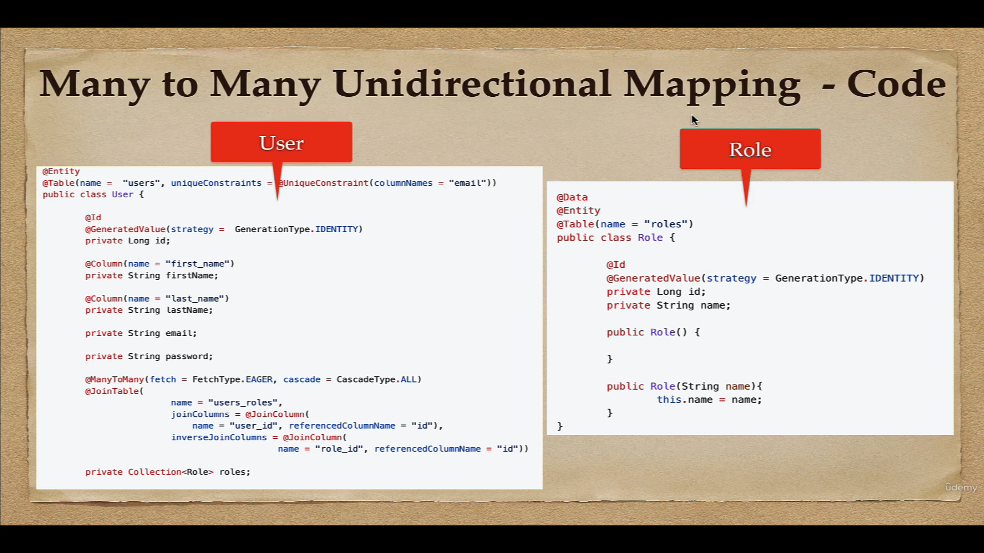

Slide 8
Many to Many Bidirectional Mapping
The bidirectional relationship mapping allows you to navigate the association in both directions.
We continue using User and the Role entities to perform Many to Many bidirectional mapping.
In bidirectional mapping, we use @ManyToMany annotation on both the entities.

Slide 9
